Slide 1
Google Classroom Instructions
These are some basic navigational instructions for this learning platform. We highly suggest that you take some time to explore the website with your child to become familiar with it this weekend. We are all learning how to use Google Classroom together, so please take it one step at a time. If you have any questions or concerns, please do not hesitate to reach out to your child’s teacher.
Thank you!
** As a reminder, remote learning on Google Classroom will being on Monday March 23rd at 9:00am. Attendance data will be officially recorded for our school records.

Slide 2
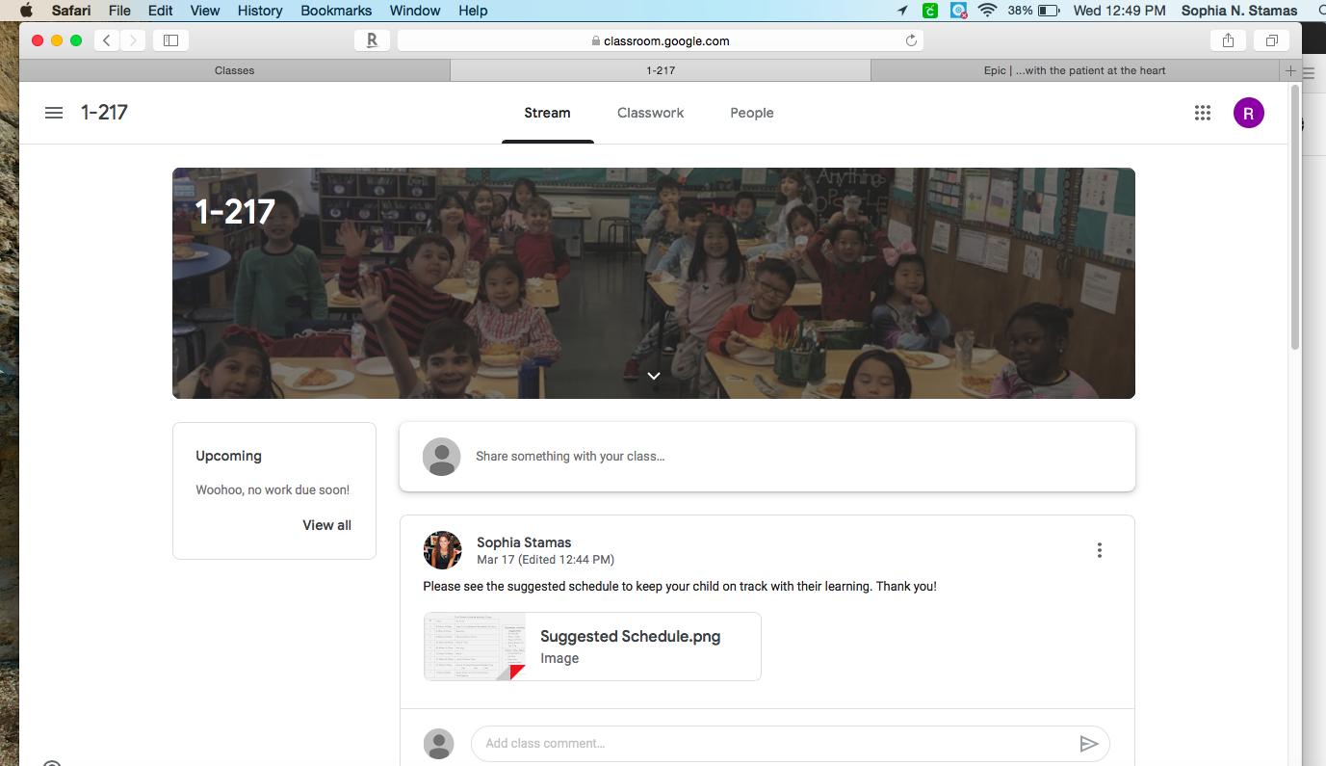
Step 1: Log in and click on your class (1-217).
Step 2: Check the “stream” tab for announcements.
**Parents you can post questions in this tab and help each other out if you come across any questions or difficulties.

Slide 3
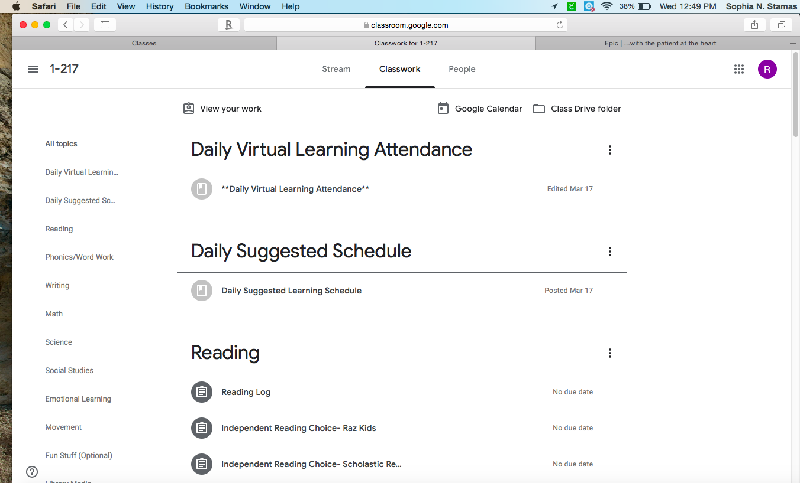
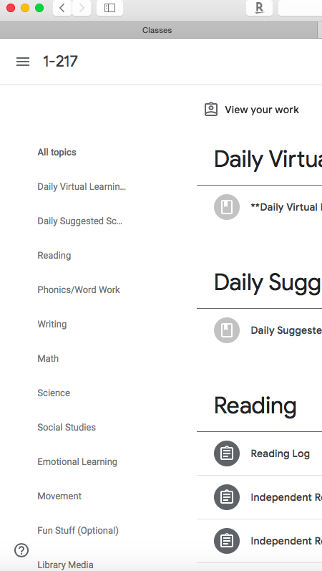
Step 3: Click on the “classwork” tab.
Complete your attendance daily between 9-10am.
**Be sure to fill out attendance if your child is also in ESL or SETTS on their specific Google classroom page.
View the suggested schedule
Step 4: Look under each of the content area headings (reading, writing, math). Please select the activities that you will be doing with your child.
**Be mindful that some assignments have specific due dates and some assignments will be used daily, throughout this program.

